Slide 1
INDION AKD WP
HIGH PURITY WATER SYSTEM FOR
ARTIFICIAL KIDNEY DIALYSIS

Slide 2
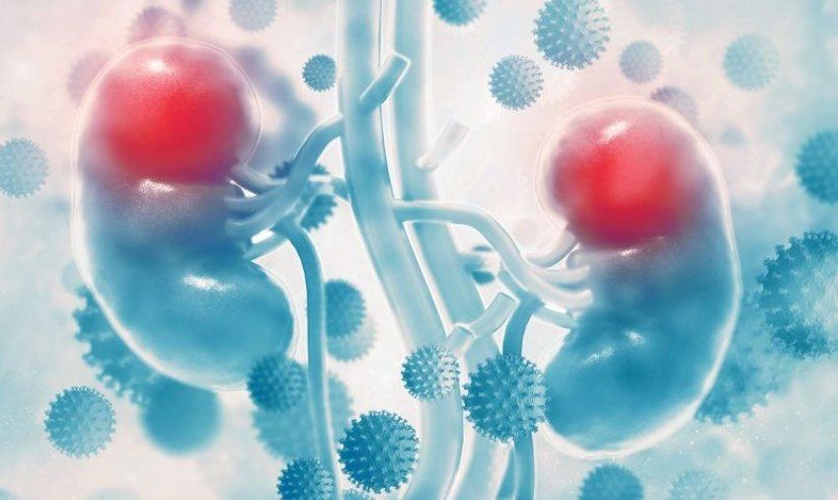
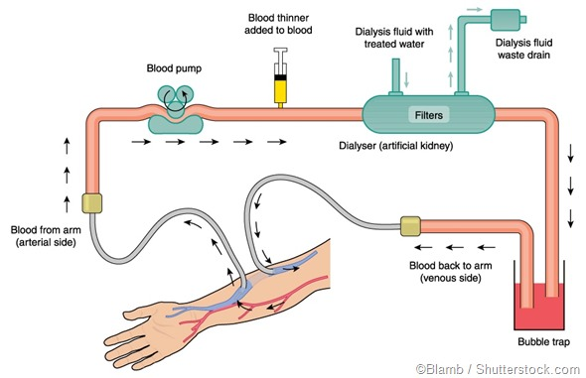
INTRODUCTION
Artificial way to remove waste and extra fluids from the body
Process of selective diffusion of solutes through membrane
High purity water mixed with electrolytes and salts, such as bicarbonate and sodium to form Dialysate
Heart of Haemodialysis WATER
Patients exposed to large amount of water during dialysis

Slide 3
WHY PURIFICATION OF WATER IS REQUIRED ?
Impurities | Allowable Limit (mg/l) | Causes
Aluminum | 0.01 | Dialysis Dementia
Chloramines | 0.1 | Acute Hemolytic Anemia
Fluoride | 0.2 | Toxicity, Bone Diseases
Lead | 0.005 | Gastro Intestinal Pain, Muscle Weakness
Sulphate | 100 | Nausea, Metabolic Acidosis
Calcium | 2 | Hypertension, Nausea, Vomiting
Magnesium | 4 | Muscle Weakness
Nitrate | 2 | Methemoglobinemia
Bacteria | < 100 CFU/ml | Nausea, Vomiting, Bloodstream Infection, Death
Endotoxin | < 0.25 EU/ml | Pyrogenic reaction, Death
Source of Data : Guideline on water treatment systems, dialysis water and dialysis fluid quality for haemodialysis and related therapies prepared on behalf of The Renal Association and The Association of Renal Technologists

Slide 4

Treated Water Quality
As per AAMI 13959:2014
Microbiological Level | Previous standard | New Standard | Previous Action Level | New Action Level
Colony Forming Units | < 200 CFU/ml | < 100 CFU/ml | = 50 CFU/ml | = 50 CFU/ml
Endotoxin Units | < 2 EU/ml | < 0.25 EU/ml | = 1 EU/ml | = 0.125 EU/ml

Slide 5
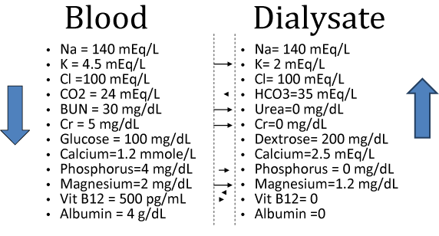
Dialysate

Slide 6
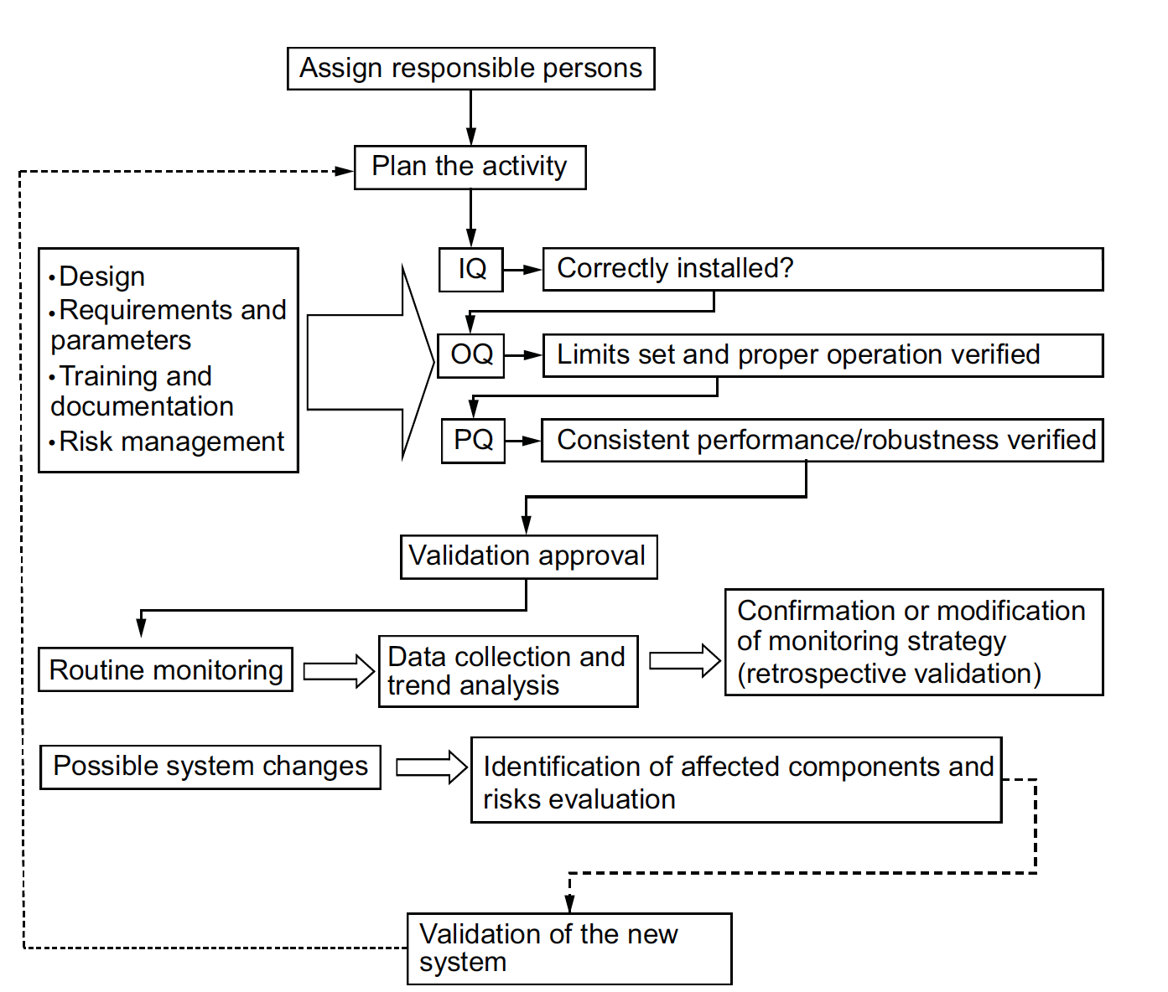
Assurance of Treated Water Quality

Slide 7


AKD- Water Treatment Plant
Features
Advantages
Scientifically designed system
All pipings are of electro polished stainless steel
Sanitary design of all equipments & components
Hot water sanitisable RO and UF Membranes
UV system post Ultra filtration
PLC controlled system with safety interlocks
Touch screen display
Available both fully auto and semi auto mode with wide range of capacities
Dead lag free system
No risk of bio film formation
Right quality of water as per AAMI standards
Compact and Portable system
Multi stage protection from Bacteria and Endo toxins
Chemical free sanitization

Slide 8

AKD- Water Treatment Plant
Benefits
High rejection of TOC, pyrogens, Bacteria and Endotoxin
Easy system operation
Minimum footprint and easy access for maintenance
Safety in dialysis operation

Slide 9
PROCESS FLOW
Sand Filter
Activated
Carbon Filter
Softener
Raw Water Storage Tank
PREFILTERATION
Micron Cartridge Filter
To Dialysis Units
Treated Water Storage Tank
UV
HSUF
HSRO

Slide 10
NORMAL RO Vs AKD WP
Description | Normal RO Plant | AKD Water Treatment Plant
Design | Ordinary design | Scientifically designed with no dead lags
Chances of Bio Film Formation | High | Low
MOC of functional components | PVC/MS/PEX/PVDF | Electro polished stainless steel with Ra value < 0.8 µm
RO Membrane | Commercial Grade | Hot Water Sanitisable RO
UF Membrane/ Hollow Cartridge Filter | Not Available | Hot Water Sanitisable/ Auto Clave Sanitisable
Type of Cleaning | Chemical Cleaning | Hot water sanitization and if require chemical cleaning

Slide 11
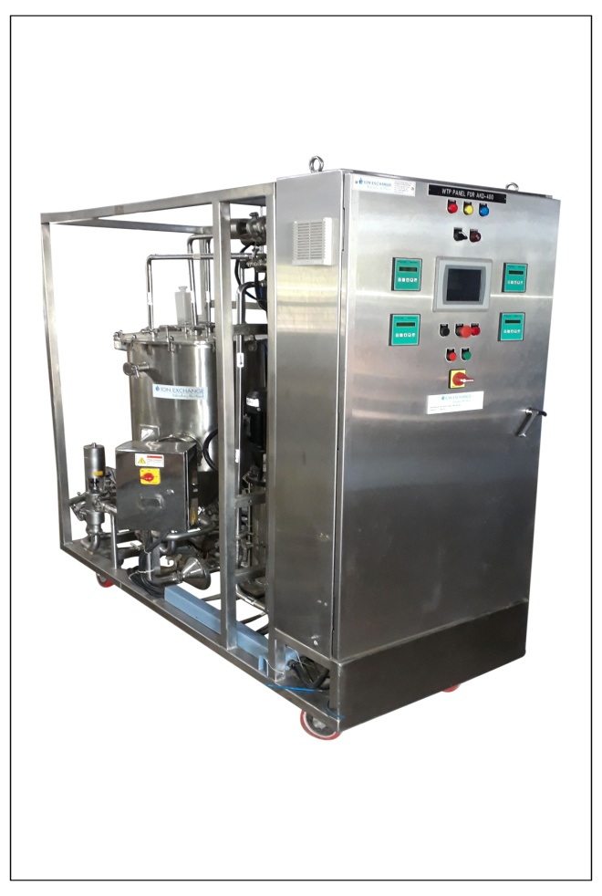
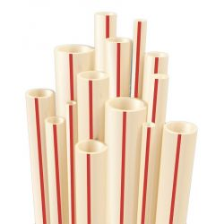
AKD- Water Treatment Plant
Scientifically designed system
Suites well for Hygiene Applications
Electro polished Stainless steel with Ra value < 0.8µM
Zero Bio fouling
AKD WP with 400 LPH Capacity
No PEX/PVDF or Flexible Plastics are used

Slide 12
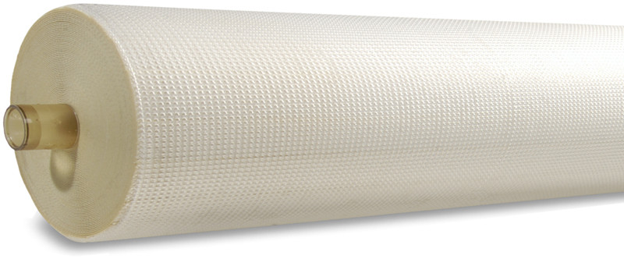
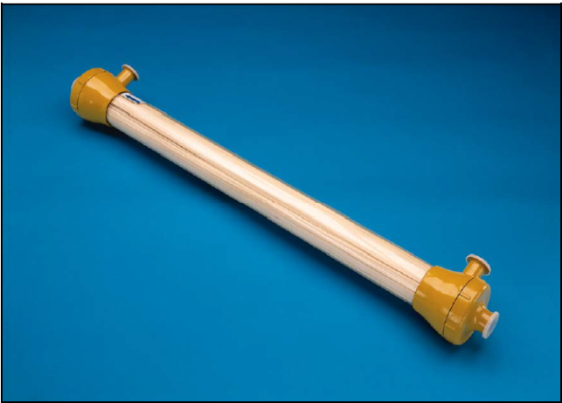
AKD- Water Treatment Plant
Hot Water Sanitisable RO membranes
High capability to withstand Hot water sanitization
Full Fit configuration with minimum stagnant area
Comply with FDA standards
Hot Water Sanitisable Ultra filtration
High Water Productivity with large membrane area
High Thermo Durability
Very Low Effluent
Excellent Chemical Resistance
Produces Pyrogens free water

Slide 13
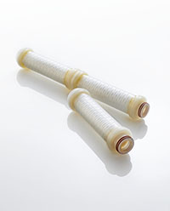
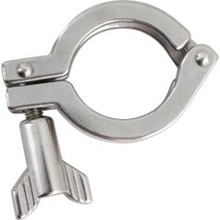
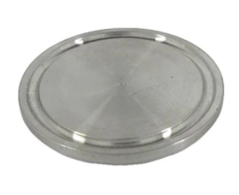
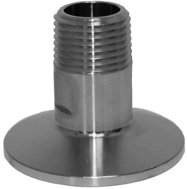
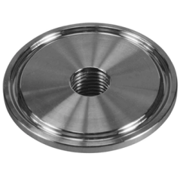
AKD- Water Treatment Plant
Endotoxin removable Hollow fiber Cartridge Filtration (For semi auto systems)
Excellent removal of Bacteria and Endotoxin
High Water Productivity
Higher Filter Life
Sanitary Fittings
Stainless steel Tri clover clamps and ends with High precision machining and Surface polishing
Easy to install and remove for maintenance

Slide 14
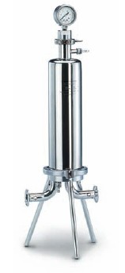
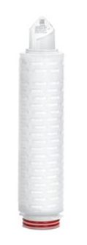
AKD- Water Treatment Plant
Micron Cartridge Filter
Cartridges for Pre filtration provides valuable protection for RO membrane.
High dirt loading capacities, with long service
High Chemical compatibility
High Temperature Sustainable, Food Grade Gaskets for avoiding leakage
Sample points at every stage to ensure quality
Online Conductivity, pH and ORP meters for monitoring quality of water

Slide 15
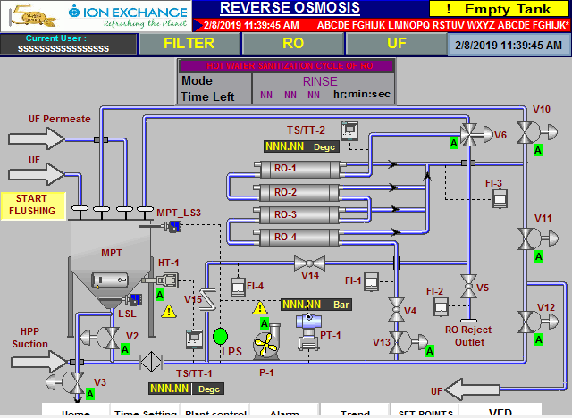
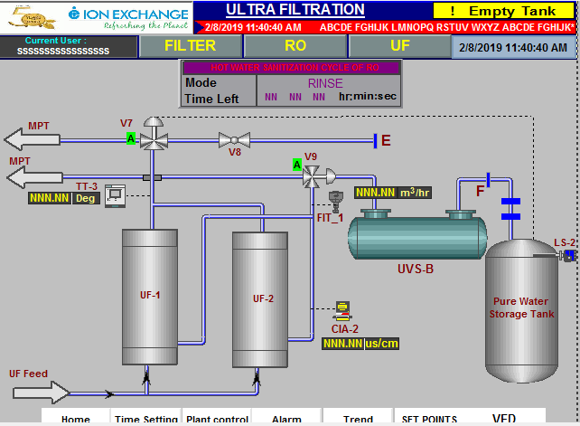
AKD- Water Treatment Plant
USER INTERFACE
User friendly 7” touch screen display to control the components

Slide 16
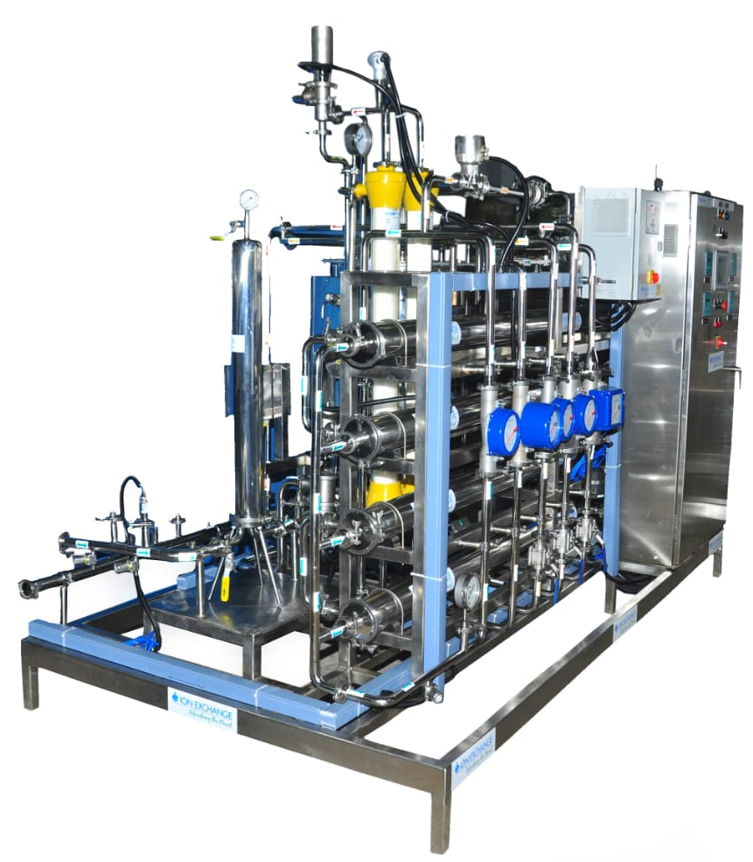
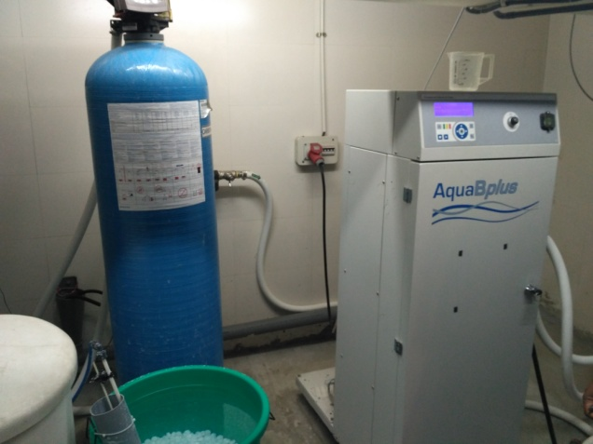
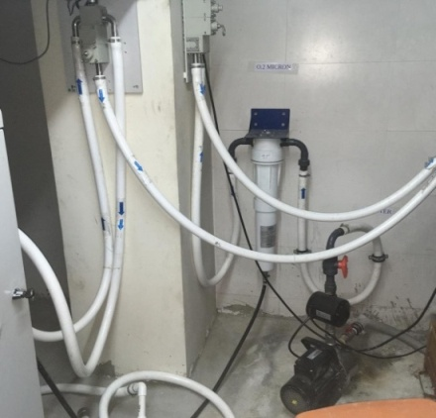
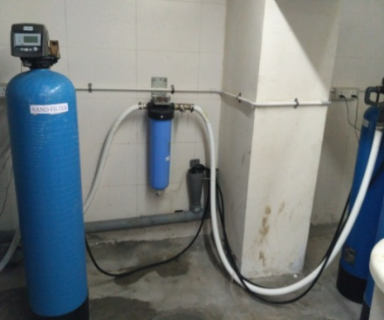
AKD- WP Vs Competitors
AKD WP - 1500 LPH
Competitor RO for dialysis

Slide 17
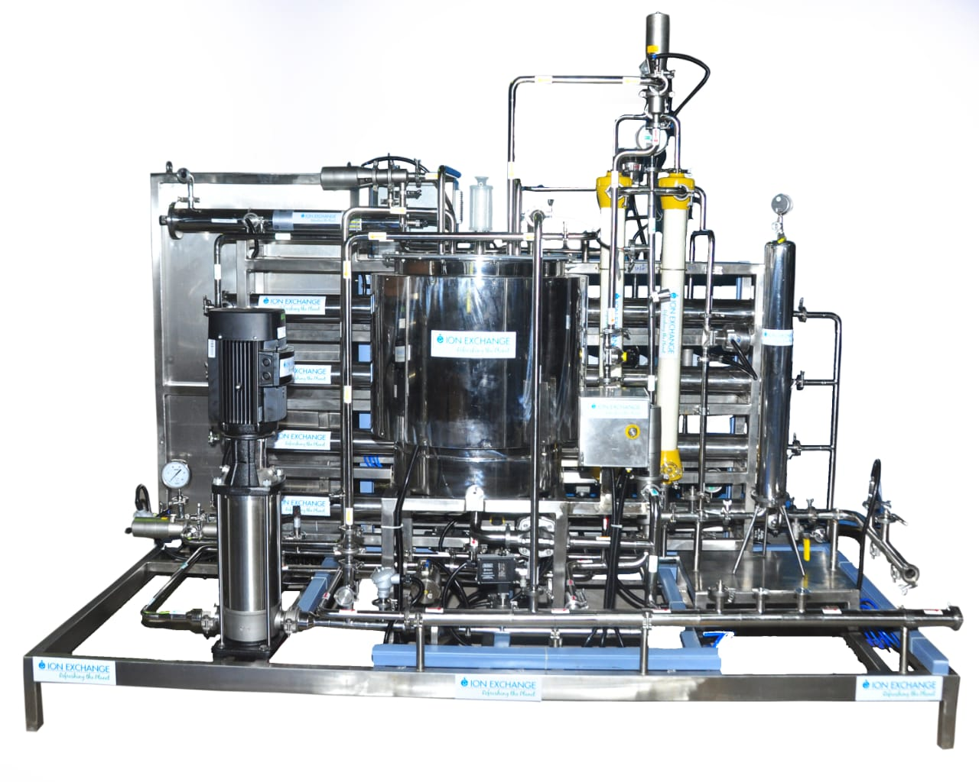
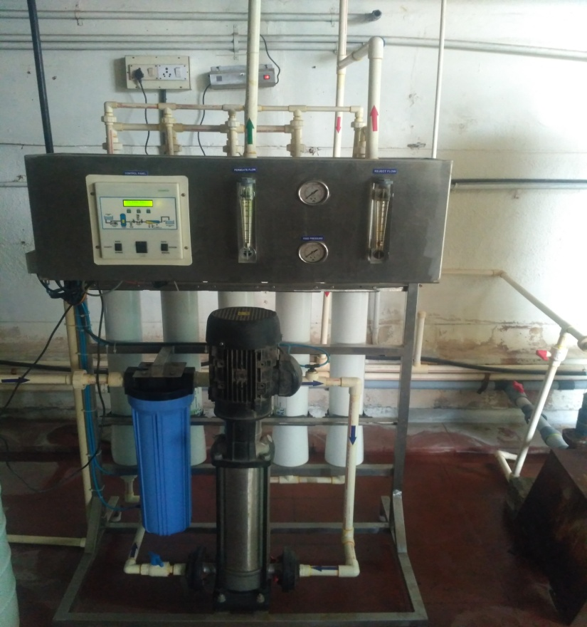
AKD- WP Vs Competitors
AKD WP - 1500 LPH
Competitor RO for Dialysis

Slide 18
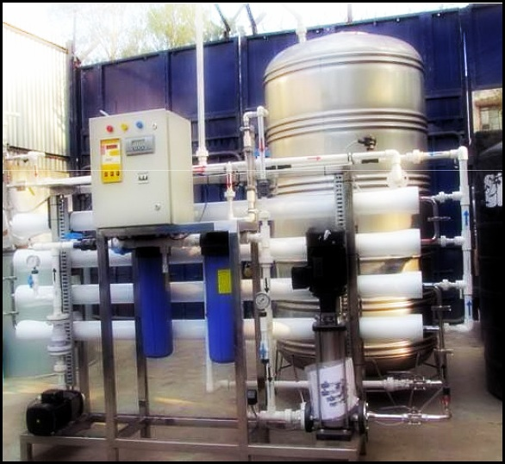
AKD- WP Vs Competitors
AKD WP - 400 LPH
Competitor RO for Dialysis

Slide 19
FEED WATER CONDITIONS
Sl. No. | Parameters | Inlet water quality
a. | pH range, Short Term Cleaning | 1-12
b. | Residual Chlorine | Nil
c. | Turbidity | <1 NTU
d. | Suspended solids | Nil
e. | SDI | < 4
f. | Temperature | < 40°C
g. | Organics and Bacteria | Nil
h. | Heavy Metals | < 0.1 ppm
i. | TDS | Potable Water

Slide 20
TECHNICAL SPECIFICATIONS
AKD Basic - Semi Automatic System
Model | AKD-100 | AKD-400 | AKD-1000 | AKD-1500
Type | BASIC Semi Auto | BASIC Semi Auto | BASIC Semi Auto | BASIC Semi Auto
Average product flow(LPH) | 100 | 400 | 1000 | 1500
Average Recovery(%) | 30 | 30-85 | 30-85 | 30-85
Maximum Permissible TDS feed (PPM) | 1500 | 1500 | 1500 | 1500
Average TDS Removable (%) | Between 90-95 | Between 90-95 | Between 90-95 | Between 90-95
Minimum feed pressure required at pump inlet (kg/cm²) | Not less than 1.0 | Not less than 1.0 | Not less than 1.0 | Not less than 1.0
Cartridge Housing | SS316 | SS316 | SS316 | SS316
Cartridge MOC | PP | PP | PP | PP
RO SYSTEM
Membrane | 4"-HSRO | 4"-HSRO | 4"-HSRO | 4"-HSRO
Pressure Tube | SS316L | SS316L | SS316L | SS316L
Skid | SS304 | SS304 | SS304 | SS304
Hollow Fibre Cartridge System
Cartridge | 0.05 Micron 10” | 0.05 Micron 10” | 0.05 Micron 10” | 0.05 Micron 10”
MOC | SS 316 | SS 316 | SS 316 | SS 316

Slide 21
TECHNICAL SPECIFICATIONS
AKD Basic - Semi Automatic System
HIGH PRESSURE PUMP
MOC | SS316 | SS316 | SS316 | SS316
Quantity | 1No | 1No | 1No | 1No
MULTI PURPOSE TANK | SS 316 | SS 316 | SS 316 | SS 316
Skid | SS 304 | SS 304 | SS 304 | SS 304
UV System (Optional)
PLC | PLC with 4.3” HMI Display

Slide 22
TECHNICAL SPECIFICATIONS
AKD Advanced - Fully Automatic System
Model1 | AKD-100 | AKD-400 | AKD-1000 | AKD-1500
Type | ADV Fully Auto | ADV Fully Auto | ADV Fully Auto | ADV Fully Auto
Average product flow(LPH) | 100 | 400 | 1000 | 1500
Average Recovery(%) | 30 | 30 | 35 | 55
Maximum Permissible TDS feed (PPM) | 1500 | 1500 | 1500 | 1500
Average TDS Removable (%) | Between 90-95 | Between 90-95 | Between 90-95 | Between 90-95
Minimum feed pressure required at pump inlet (kg/cm²) | Not less than 1.0 | Not less than 1.0 | Not less than 1.0 | Not less than 1.0
Cartridge Housing | SS316 | SS316 | SS316 | SS316
Cartridge | PP | PP | PP | PP
RO SYSTEM
Membrane | 4"-HSRO | 4"-HSRO | 4"-HSRO | 4"-HSRO
Pressure Tube | SS316L | SS316L | SS316L | SS316L
Skid | SS304 | SS304 | SS304 | SS304
UF SYSTEM
Membrane Type | 6000 MWCO | 6000 MWCO | 6000 MWCO | 6000 MWCO

Slide 23
TECHNICAL SPECIFICATIONS
AKD Advanced – Fully Automatic System
UV SYSTEM
MOC | SS316 | SS316 | SS316 | SS316
End connection | Tri-clamp | Tri-clamp | Tri-clamp | Tri-clamp
HIGH PRESSURE PUMP
MOC | SS316 | SS316 | SS316 | SS316
Quantity | 1 No | 1 No | 1 No | 1 No
MULTI PURPOSE TANK | SS316 | SS316 | SS316 | SS316
PLC | Non redundant PLC with 7" HMI

Slide 24
AKD Basic vs AKD Advanced
Model | AKD Basic | AKD Advanced
Cartridge Filter
MOC Housing | SS 316 | SS 316
MOC Cartridge | PP Cartridge | PP Cartridge
Pressure Tube
MOC | SS 316L | SS 316L
High Pressure Pump
MOC | SS 316 | SS 316
VFD | - | Available | Automatically controls the pressure of HPP
CM series Pump | Available | - | Additional pump with reduced pressure for chemical cleaning purpose
RO
Membrane | 4” HSRO | 4” HSRO
Hollow Fiber Cartridge filter | 0.05 Micron 10” SS 316 | -
UF | - | Polysulfone, 6000 MWCO

Slide 25
AKD Basic vs AKD Advanced
Model | AKD Basic | AKD Advanced
Multi Purpose Tank with Heater
MOC | SS 316 | SS 316
UV System | Optional | Available
Valves | Manual/ Auto | Auto
Instruments
Pressure Gauge | 3 Nos | 5 Nos
Pressure Transmitter | - | 2 Nos
PH Transmitter | 1 No | 1 No
ORP analyzer | 1 No | 1 No

Slide 26
AKD Basic vs AKD Advanced
Model | AKD Basic | AKD Advanced
Conductivity analyzer | 1 No | 2 Nos
Level Switch | 1 No | 1 No
Temperature sensor | - | 1 No
Temperature Transmitter | 2 Nos | -
Flow Indicator | 3 Nos | 1 No
Flow Transmitter | 1 No | 4 Nos
PLC | PLC with 4.3" HMI | Non redundant PLC with 7" HMI

Slide 27
THANK YOU...

